Slide 1
Smart India Hackathon (SIH)
Problem Statement : Student Innovation
Theme : Smart Education

Slide 2




The Student Struggle: Disorganized Study Materials
Limited Resources
Lack of Centralization
Students waste precious hours searching for notes, assignments, and crucial resources scattered across disparate platforms.
The absence of a centralized, subject-wise repository creates confusion, duplicates efforts, and results in missed learning opportunities.
Ineffective Tools
Existing solutions often fall short, being either too generic for academic needs or lacking the intuitive upload and sharing functionalities specifically tailored for student collaboration.

Slide 3

Get Updated !
Your Ultimate Student File Hub

Slide 4

Introducing “Get Updated”: Your Centralized Learning Platform
File Hub
Seamless Organization
Get Updated is a platform designed to streamline academics, providing a single destination where students can effortlessly find and upload files, all organized by subject.
Our seamless subject-wise categorization ensures lightning-fast access to relevant study materials, transforming scattered data into a structured knowledge base.
Empowered Collaboration
We empower students to actively contribute, collaborate, and collectively build a dynamic, shared knowledge base.

Slide 5
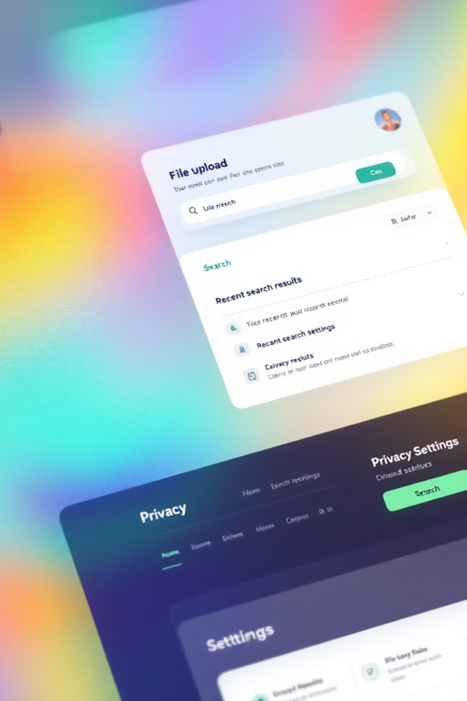



How It Works: Simple, Smart, Secure
Upload Any File
Intelligent Search
Effortlessly upload any file type – from lecture notes and presentation slides to complex assignments and valuable past papers – making all your resources instantly accessible.
Navigate with ease: browse or search precisely by subject, specific course, or topic. Our AI-powered search suggestions ensure you always find what you need, quickly.
Secure Sharing
Maintain complete control over your content with robust privacy controls, allowing you to define exactly who can view or download your uploaded files, ensuring secure sharing.

Slide 6





Key Features: Designed for Academic Success
Smart Organization
Real-time Collaboration
Mobile Accessibility
Security

Slide 7
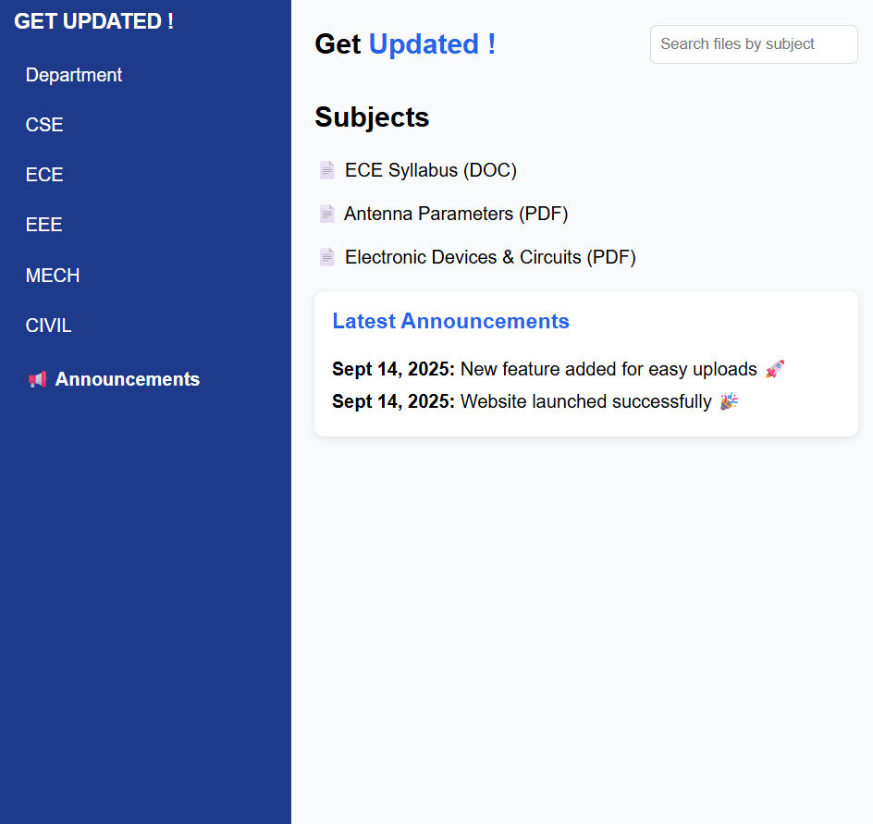
Announcements Section :
In this Platform we are going to Avail a Announcement section which help all users to know about latest data posted in platform and it's mainly focused to inform users about the latest techniques.

Slide 8
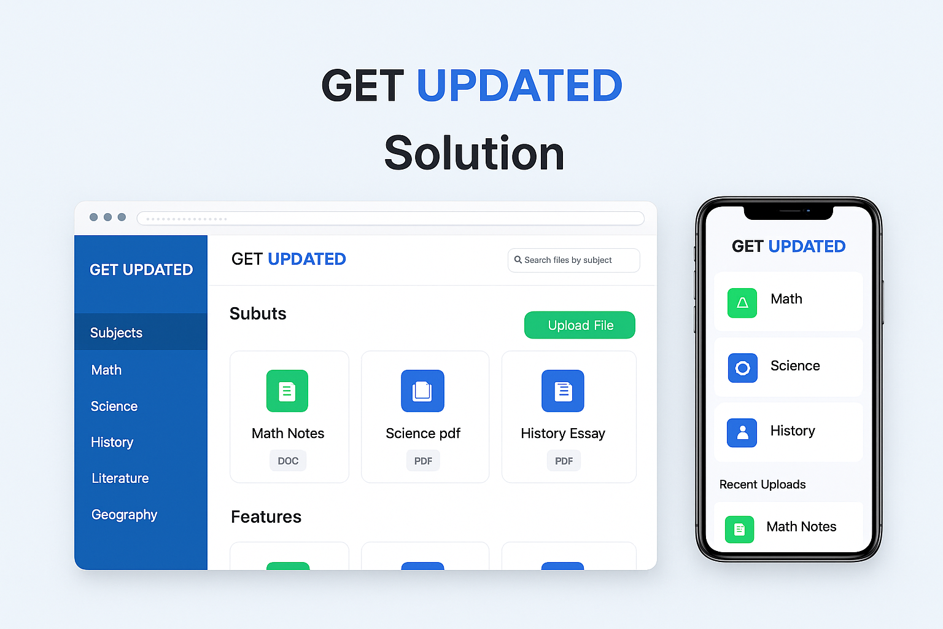
CONCLUSION :
Finally , With this idea the students problems will be reduced about materials , classes , Syllabus , Exams … and easily get updated about the fests and events conducting by surrounding colleges as well
This is the Brief about our Idea
Get Updated !
Your Ultimate Student File Hub​

Slide 9
Any Queries ?

Slide 10
Thank You

